Slide 1
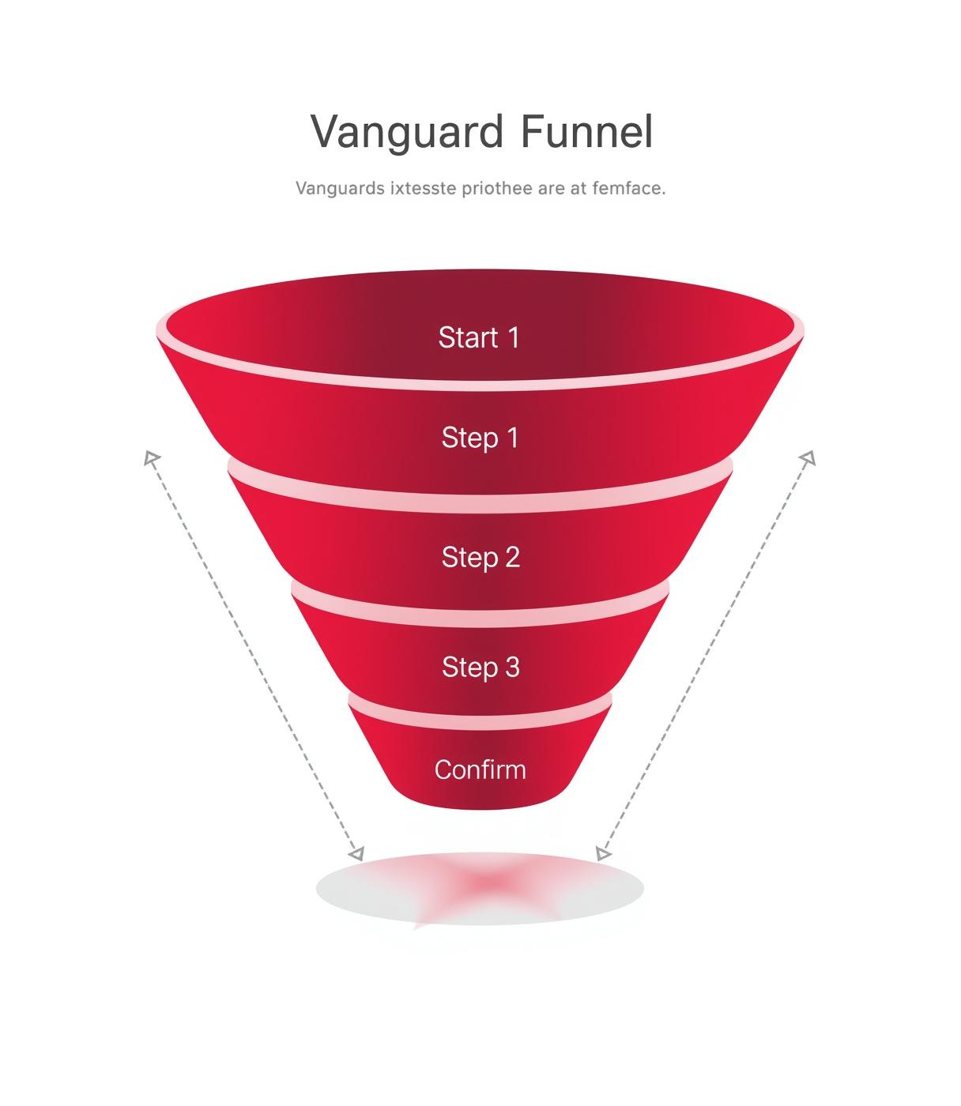

CX Funnel - A/B test
Customer Experience (CX) team
Context: A/B test of legacy UI (Control) vs redesigned UI (Test) on a 5-step funnel process: Start → Step 1 → Step 2 → Step 3 → Confirm.
Period: 2017-03-15 to 2017-06-20.
Primary question: Did the new UI lead to higher completion rates?
PRESENTED BY
Luis Pablo Aiello

Slide 2
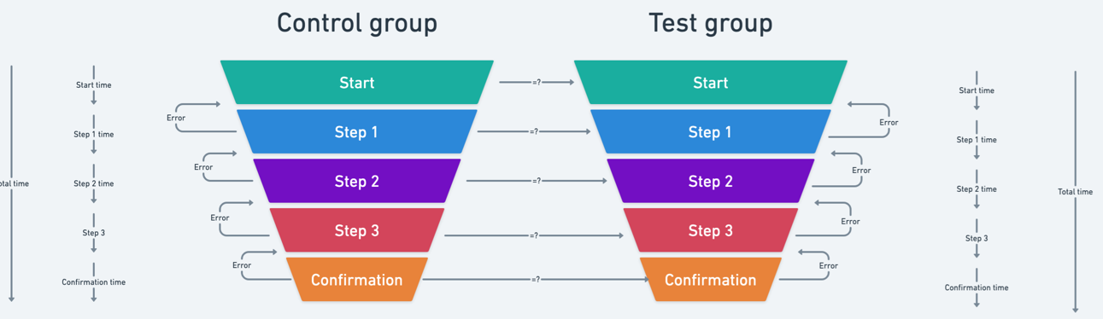
A/B Test Overview
Vanguard CX Funnel A/B Test presents an intriguing exploration into how user interface (UI) redesigns can impact completion rates across a five-step customer journey. In analyzing funnels, it's crucial to distinguish between sequential (closed) and non-sequential (open) models, as each offers unique insights based on entry and progression through the steps.
Sequential funnels require users to begin at the initial step, ensuring a strict order which is essential for processes where each action builds upon the previous one, such as security checks.
In contrast, non-sequential funnels allow entry at any point, providing flexibility in understanding user behavior and partial journey analysis, which is beneficial in more adaptable process flows.
The choice between these models significantly affects the analysis, influencing how data is interpreted and which insights can be drawn regarding user engagement and UI efficacy.
Therefore, Vanguard's A/B test findings depend on the type of funnel used, which shapes conclusions about the success of the UI redesign in improving user completion rates.

Slide 3
Funnel Process Overview & Analysis
process sequence: start(0) → step_1(1) → step_2(2) → step_1(1) → step_2(2) → step_3(3)
- fail = didn't reached confirm(4)
- step backs = 1 -> step_2(2) → step_1(1)
analysis = when multiple step_1(1) &/| step_2(2) &/| step_3(3) &/| step_4(4) &/| confirm(4) drop all except last one of each.
- to compute times in this case we can drop the first step_1(1) → step_2(2) and compute the time from start(0) → step_1(1) as the total time between start(0) and the second step_1(1) = start(0) → step_1(1) → step_2(2) → step_1(1), therefore the total time spent from start(0) to reach step_1(1) will be the subtraction of the time of the second step_1(1) - start(0)
process sequence: step_3(3) → step_2(2) → step_3(3) → confirm(4) → start(0) → step_1(1)
- anomaly = funnel sequential process cannot start on any other step that != start(0)
reason = first chronological event != start
rocess sequence: start(0) → step_1(1) → step_3(3) → confirm(4)
- anomaly = funnel sequential process cannot skipp steps
reason = reached_confirm with missing previous step(s)
process sequence: start(0) → step_1(1) → step_2(2) → step_3(3) → confirm(4)
- sucessfull = process has reached confirm(4) without back-jumps
process sequence: start(0) → step_1(1) → step_1(1) → step_2(2) → step_3(3) → step_1(1) → step_1(1) → step_2(2) → step_1(1)
- fail = didn't reached confirm(4)
- back-jumps = 2 -> step_3(3) → step_1(1) | step_2(2) → step_1(1)
- analysis = when multiple step_1(1), drop all except last
- problem: time lapsed between step_1(1) → step_2(2) and step_2(2) → step_3(3) will result in negative value since last step_1(1) is after the last step_2(2)
process sequence: start(0) → start(0) → start(0) → step_1(1) → step_2(2) → step_1(1) → step_2(2) → step_3(3)
- fail = didn't reached confirm(4)
- back-jumps = 1 -> step_2(2) → step_1(1)
- analysis = when multiple start(0), drop all except first one.
process sequence: start(0) → step_1(1) → step_2(2) → step_3(3) → step_2(2) → step_3(3) → step_2(2) → step_1(1) → step_2(2) → step_3(3) → start(0) → step_1(1) → step_2(2) → step_3(3) → confirm(4) → confirm(4) → confirm(4)
- completed_with_errors = start in start(0) & reached confirm(4)
- back-jumps = 4 -> step_3(3) → step_2(2) | step_3(3) → step_2(2) | step_3(3) → step_2(2) | step_3(3) → start(0)
- analysis = when multiple step_1(1) &/| step_2(2) &/| step_3(3) &/| step_4(4) &/| confirm(4) drop all except last one of each.

Slide 4
Dataset Sizes
Overview of key fields and sizes for each dataset
Clients dataset:
client_id: 70609 (nulls 0)
clnt_tenure_yr: 70595 (nulls 14)
clnt_tenure_month: 70595 (nulls 14)
clnt_age: 7594 (nulls 15)
gendr: 70595 (nulls 14)
num_acsts: 70595 (nulls 14)
bal: 70595 (nulls 14)
calls_6_mnth: 7595 (nulls 14)
logons_6_mnth: 70595 (nulls 0)
Test clients dataset:
Clients: 26,968
with_nulls: 7
Control clients dataset:
Clients: 23,532
with_nulls: 6
web_data_test:
Original web rows: 341,046
Filtered web rows (test only): 139,342
Distinct test clients with activity: 22,007
Test clients without any web activity: 4,954
Experiment Clients:
client_id: 70,609 (nulls 0)
Variation: 50,500
Test: 26,968
Control: 23,532
NaN: 20,109
web_data_control:
Original web rows: 341,046
Filtered web rows (control only): 100,569
Distinct control clients with activity: 18,011
Control clients without any web activity: 5,515

Slide 5
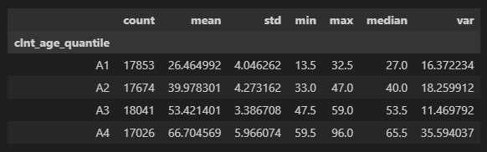
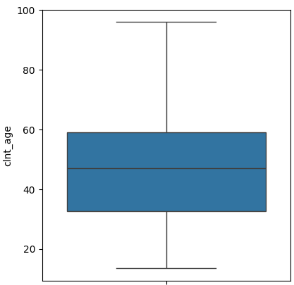
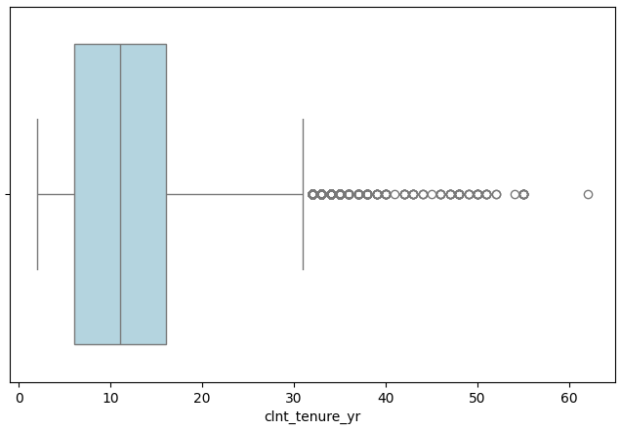
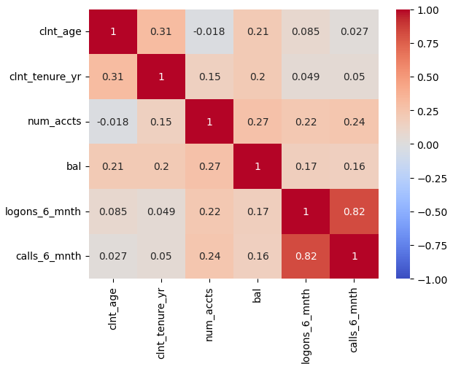
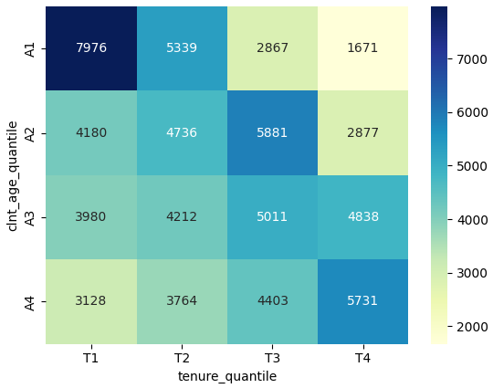
Exploratory Data Analysis
CLIENTS AGE DISTRIBUTION
TENURE BY AGE DISTRIBUTION
Age Variance: 243.09
Age Range: 13.5 - 96.0
Age IQR: 26.5
Age mean: 46.44
Age median: 47
Age mode: 58.55
ACCOUNTS SUMMARY
Balance Variance: 90907500113.94 Balance Std Deviation: 301508.71
Balance Range: 13,789.42 - 16,320,040.15 Balance Average: 147445.24
Balance IQR: 100,198.07

Slide 6
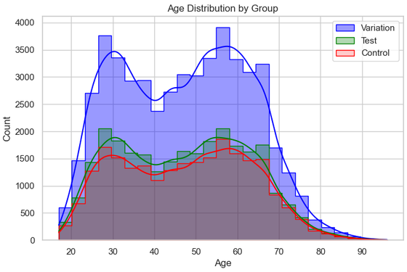
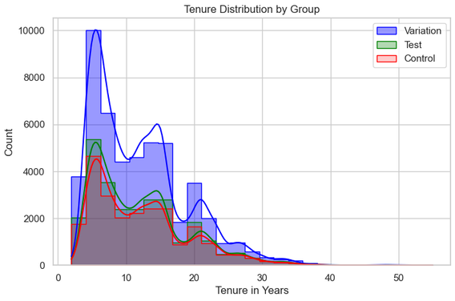
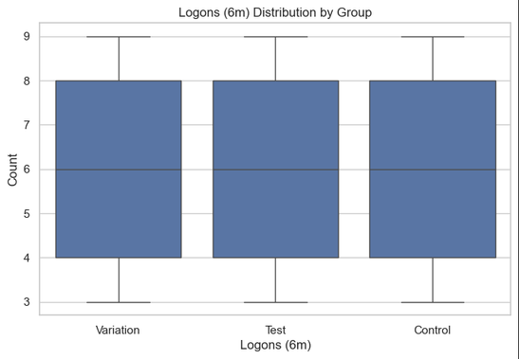
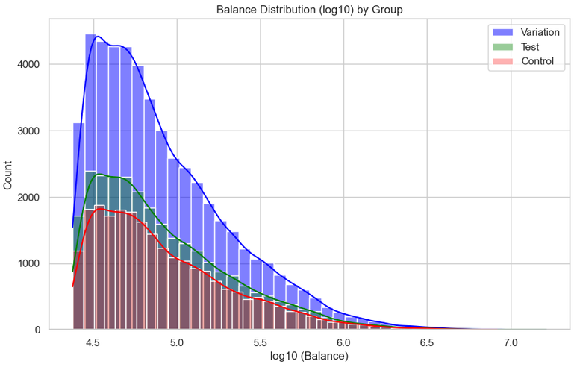
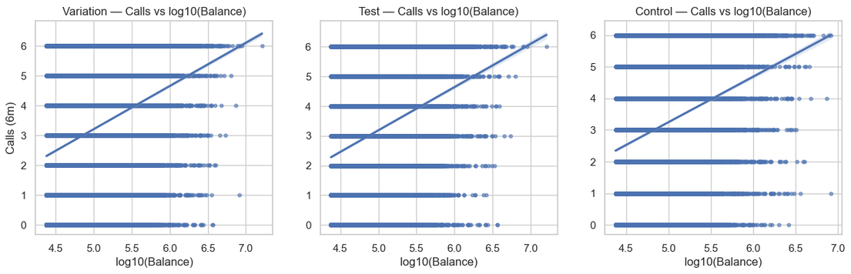
Group Balance
This section highlights the baseline group balance and correlations among key client features, ensuring our analysis is robust and reliable for subsequent assessments. Full group balance analysis could be seen in demographic_analysis_viz.ipynb
Variation = All clients assigned to Test and Control groups

Slide 7
Pseudocode
# ================================================================
# 3. DETECT STEP BACKS
# ================================================================
# 11. Function compute_back_jumps(w_full):
# a. Map each row’s step to numeric index (step_idx)
# b. For each process (grouped by KEY) compute previous step index
# c. delta = current_step_idx - prev_step_idx
# d. Flag is_back_jump if delta < 0 (means user moved backward)
# e. Aggregate number of back jumps per process (sum)
# f. Return:
# - wf: detailed events with step indices and back-jump flags
# - back: table (one row per process) with count of back jumps
# ================================================================
# 4. KEEP ONLY LAST OCCURRENCE OF EACH STEP
# ================================================================
# 12. Function collapse_last_per_step_and_last_confirm(wf):
# a. If multiple 'confirm' events exist in a process, keep only the last one
# b. Sort by KEY + process_step + time
# c. Drop all but the LAST occurrence of each step per process
# d. Return this condensed table (one row per step per process)
# ================================================================
# 5. SUMMARIZE PROCESSES INTO ONE ROW EACH
# ================================================================
# 13. Function summarize_processes(wf2, back):
# a. Pivot timestamps so each process has columns for each step time
# b. Ensure missing steps become NaT (missing timestamp)
# c. Convert all datetimes to naive UTC (remove timezone)
# d. Create binary reached_* flags (1 if timestamp exists, else 0)
# e. completed = reached_confirm
# f. Compute time differences (minutes) between:
# - start → step_1
# - step_1 → step_2
# - step_2 → step_3
# - step_3 → confirm
# - start → confirm (total)
# g. Join in back-jump counts
# h. Define outcome:
# - "successful" if completed AND no back jumps
# - "completed_with_errors" if completed AND back jumps > 0
# - "fail" if not completed
# i. Return one-row-per-process table with flags, times, outcome
# ================================================================
# 5. SUMMARIZE PROCESSES INTO ONE ROW EACH
# ================================================================
# 13. Function summarize_processes(wf2, back):
# a. Pivot timestamps so each process has columns for each step time
# b. Ensure missing steps become NaT (missing timestamp)
# c. Convert all datetimes to naive UTC (remove timezone)
# d. Create binary reached_* flags (1 if timestamp exists, else 0)
# e. completed = reached_confirm
# f. Compute time differences (minutes) between:
# - start → step_1
# - step_1 → step_2
# - step_2 → step_3
# - step_3 → confirm
# - start → confirm (total)
# g. Join in back-jump counts
# h. Define outcome:
# - "successful" if completed AND no back jumps
# - "completed_with_errors" if completed AND back jumps > 0
# - "fail" if not completed
# i. Return one-row-per-process table with flags, times, outcome
# ================================================================
# 6. CALCULATE KPIs (Control Group) and Test Group metrics
# ================================================================
# 14. Function kpis_from_processes(proc):
# a. Denominator = number of processes that “started” (reached_start)
# b. Compute percent reaching each step (step_1, step_2, step_3)
# c. Compute completion_rate_% (confirm reached)
# d. Compute distribution of outcomes (successful, completed_with_errors, fail)
# e. Compute median times between each transition + total
# f. Compute average number of back jumps
# g. Return a one-row DataFrame with KPI values
# 15. Function step_dropoff_table(proc):
# a. For each step transition (start→step_1, step_1→step_2, etc.):
# - n_from = number of processes that reached the “from” step
# - n_to = number that reached the “to” step
# - conv_rate_% = (n_to / n_from)*100
# - dropoff_% = 100 - conv_rate_%
# b. Return a table describing funnel conversion and drop-off rates
# ================================================================
# 0. IMPORTS & CONFIG
# ================================================================
# 1. Import Python libraries (yaml, pandas, numpy, datetime, plotting, stats, etc.)
# 2. Try to open a YAML config file (../config.yaml). If not found, print a warning.
# 3. Read 3 CSVs from config:
# - df_demo_test: demographic + flag data for TEST group
# - df_demo_control: demographic + flag data for CONTROL group
# - df_web_data: raw web event log (all steps, all users)
# 4. Import custom helper functions
# ================================================================
# 1. DEFINE GLOBAL CONSTANTS & SMALL HELPERS
# ================================================================
# 5. Define ordered list of funnel steps: ['start','step_1','step_2','step_3','confirm']
# 6. Make a dictionary STEP_MAP that maps each step name → numeric index
# 7. Define KEY list = ['client_id','visitor_id','visit_id']
(these uniquely identify a process)
# 8. Define a helper _to_utc(series):
# - Convert strings to datetimes
# - Localize or convert to UTC timezone
# 9. Define a helper _standardize_steps(df):
# - Lowercase step names, strip spaces, normalize to canonical names
# - Keep only rows where process_step is one of the allowed funnel steps
# ================================================================
# 2. PREPARE WEB DATA PER GROUP
# ================================================================
# 10. Function prepare_web_for_group(df_web_data, df_demo_group):
# a. Get list of client_ids for that group
# b. Filter web events to those client_ids
# c. Standardize step names
# d. Convert timestamps to UTC
# e. Sort rows by KEY + timestamp
# f. Return cleaned web events for that group

Slide 8
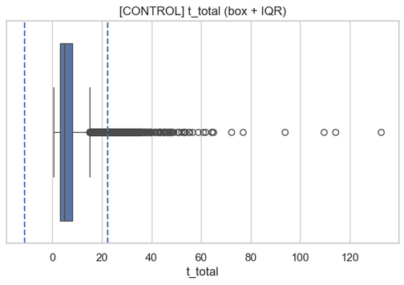
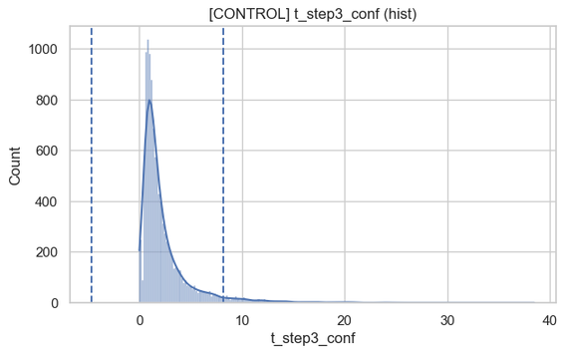
KPI Definitions
This section outlines the key performance indicators crucial for evaluating the impact of the redesigned user interface on funnel completion and conversion rates.
Valid processes: 17327
Distinct control clients with activity: 14174
Total Process in Control: 22819 → within IQR limits: 17327 | Outliers removed: 5492
t_total: outliers=338
low=-11.267, high=22.333
t_step3_conf: outliers=447
low=-4.633, high=8.200
from_to | n_from | n_to | conv_rate_% | dropoff_%
start→step_1 | 17327 | 11512 | 66.43 | 33.56
step_1→step_2 | 11512 | 9587 | 83.27 | 16.72
step_2→step_3 | 9587 | 8634 | 90.05 | 9.94
step_3→confirm | 8634 | 7436 | 86.12 | 13.87
n_processes | started | step1_rate_% | step2_rate_% | step3_rate_% | completion_rate_% | successful_% | completed_with_errors_% | fail%
17327 | 17327 | 66.43 | 55.32 | 49.82 | 42.91 | 42.91 | 0.0 | 57.08
t_total_avg_min | t_step1_avg_min | t_step2_avg_min | t_step3_avg_min | t_conf_avg_min | n_back_jumps | avg_back_jumps
4.56 | 0.59 | 0.58 | 1.50 | 1.91 | 0 | 0.0

Slide 9
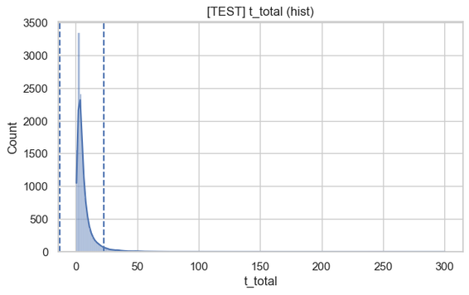
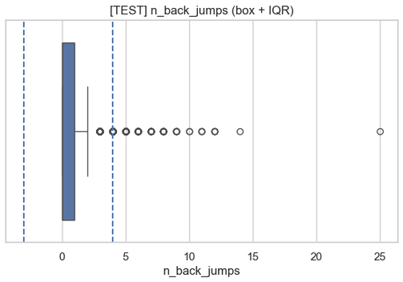
Performance Metrics Test Group
This section outlines the test metric indicators crucial for evaluating the impact of the redesigned user interface on funnel completion and conversion rates.
Valid processes: 22213
Distinct control clients with activity: 19095
Process in Test: 25932 → within IQR limits: 22213 | Outliers removed: 3719
t_total: outliers=564
low=-12.783, high=23.150
n_back_jumps: outliers=204
low=-3.000, high=4.000
from_to | n_from | n_to | conv_rate_% | dropoff_%
start→step_1 | 22213 | 18569 | 83.59 | 16.40
step_1→step_2 | 18569 | 15725 | 84.68 | 15.31
step_2→step_3 | 15725 | 14050 | 89.34 | 10.65
step_3→confirm | 14050 | 11897 | 84.67 | 15.32
Inter-quartile range (IQR): Compute quartiles: Q1 (25th pct), Q3 (75th pct), and IQR = Q3 − Q1
For a complete list of Outliers charts plese review: vanguard_funnel_outliers_viz.ipynb
n_processes | started | step1_rate_% | step2_rate_% | step3_rate_% | completion_rate_% | successful_% | completed_with_errors_% | fail%
22213 | 22213 | 83.59 | 70.79 | 63.25 | 53.55 | 43.86 | 9.69 | 46.44
t_total_avg_min | t_step1_avg_min | t_step2_avg_min | t_step3_avg_min | t_conf_avg_min | n_back_jumps | avg_back_jumps
4.34 | 1.17 | 0.54 | 1.32 | 1.46 | 74 | 0.33

Slide 10
Hypothesis Testing
This section outlines the statistical framework used for analyzing the A/B test, detailing significance levels, primary metrics, and rationale behind test choices to validate findings.
total "completed": how many processes reached 'confirm' / total "trials": how many processes actually started (reached 'start') the funnel
Control: 7436/17327 = 42.92%
Test : 11897/22213 = 53.56%
Diff (test - control): 10.64% (difference in completion rates)
The provided results are from statistical hypothesis tests comparing two groups, referred to as TEST and CONTROL, across different metrics.
Completion rate ≥ 5 percentage-point threshold — H₀: p_test − p_ctrl ≤ 0.05 (one-sided “greater”)
In the first test, the p-value for completion rate is extremely low (p=4.109e-29), which suggests a statistically significant difference favoring the TEST group over the CONTROL group.
This means we reject the null hypothesis (H0) and conclude that the TEST group has a higher completion rate.
Error rate — H₀: p_err_test − p_err_ctrl ≥ 0 (one-sided “smaller”)
In the second test, the error rate comparison shows a p-value of 1, indicating no significant difference between the TEST and CONTROL groups.
Thus, we fail to reject the null hypothesis, meaning there's no evidence that the TEST group has a lower error rate than the CONTROL group.
Time (example with t_total) — H₀: mean_test − mean_ctrl ≥ 0 (one-sided “less”)
Lastly, the total time (t_total) result shows a very low p-value (p=4.327e-09), suggesting that the TEST group completes tasks faster than the CONTROL group.
Leading us to reject the null hypothesis and conclude that the TEST group has a significantly lower mean time.

Slide 11
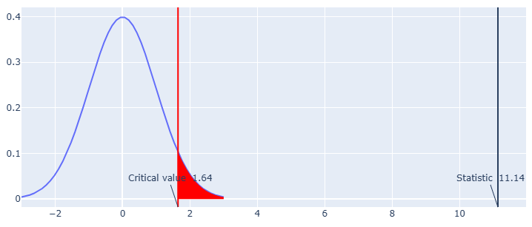
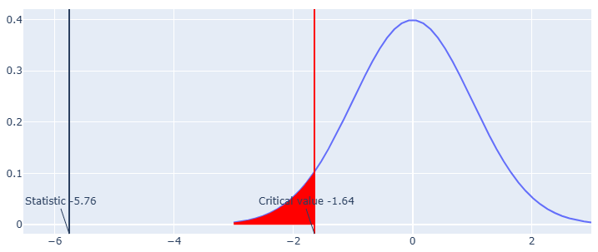
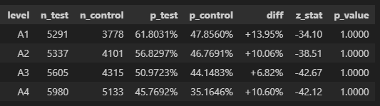
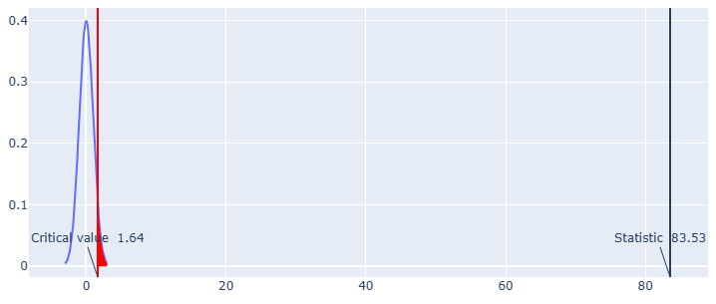
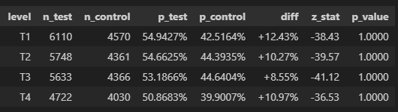
Hypothesis Testing Charts
Completion rate ≥5 percentage-point threshold
— H₀: p_test − p_ctrl ≤ 0.05 (one-sided “greater”)
Total Time rate (example with t_total)
— H₀: mean_test − mean_ctrl ≥ 0 (one-sided “less”)
Statistic = 11.14 | p_value < 0.0001 | n_test = 22213 | n_control = 17327
Statistics: -5.76 | p_value < 0.0001 | n_test: 11897 | n_ctrl: 7436
Error rate
— H₀: p_err_test − p_err_ctrl ≥ 0 (one-sided “smaller”)
Completion rates arranged by age/tenure quantiles
Statistic = 83.53 | p_value = 1.0 | n_test = 22213| n_control = 17327

Slide 12

Improvements & Next Steps
TO IMPROVE (ENGINEERING + METHODOLOGY)
NEXT STEPS (ANALYSIS & PRODUCTIZATION)
State-machine pathing for steps & times
Track first-arrival/final-exit per state; compute hop times only on forward edges; encode back-jumps as transitions.
Impact: Stabilizes hop-time KPIs under oscillations.
Deterministic handling of missing steps
Impute inferable gaps; quarantine non-inferable with reason codes; document denominators.
Impact: Prevents biased KPIs; improves auditability.
Back-step detection v2 (include “lags”)
Treat Δ=0 as stall; count repeats per step; separate back_jumps vs stalls.
Impact: Surfaces hidden friction patterns.
Transparent outlier policy & sensitivity
Parameterize IQR k in config; auto-log % removed and before/after medians; add a sensitivity table.
Impact: Avoids over/under-trimming; builds trust.
Built-in balance & SRM checks
One report prints SMDs, p-values, and SRM; fail-fast on violations.
Impact: Reduces false positives from allocation/balance issues
Device/channel stratification + FDR
Per-segment lift with CIs; Benjamini–Hochberg on secondary p-values; test interactions.
Impact: Confirms robustness; controls multiple-testing risk.
Power, MDE, and guardrails
Post-hoc power & MDE; define guardrails (error/time) with thresholds and CIs.
Impact: Clear decision gates; right-sized samples.
Variance reduction (CUPED / covariates)
Use pre-period covariate to shrink variance and tighten CIs.
Impact: More precision without more traffic.
Dashboard & alerting
Publish funnel/lift/guardrails with segment filters; alerts for SRM and guardrail breaches.
Impact: Continuous visibility; faster intervention.
Pipeline hardening & orchestration
Expose a CLI (flags: cohort, k_iqr, alpha, diff0); schedule via Airflow/Prefect; run logging (DVC/MLflow).
Impact: Reproducible, automated, auditable pipeline.

Slide 13

Thank You
VANGUARD TEAM
@reallygreatsite
CUSTOMER SUPPORT
123-456-7890
MEDIA INQUIRIES
hello@reallygreatsite

